Slide 1
Artificial Intelligence
Fuzzy Logic
ADF

Slide 2
What is Fuzzy Logic?
Convolutional Neural Network

Slide 3
Fuzzy Logic
Experts rely on common sense when they solve problems.
“People do not require precise, numerical information input, and yet they are capable of highly adaptive control.”
Professor Lotfi Zadeh, UC Berkeley, 1965

Slide 4
Fuzzy Logic
How can we represent expert knowledge that uses vague and ambiguous terms in a computer?
Accepts noisy, imprecise input!
Decisions based on “degree of truth”
Graded truth.
Truth values between True and False.
Not everything is either/or, true/false, black/white, on/off etc.

Slide 5
Fuzzy Logic
Fuzzy logic is based on the idea that all things admit of degrees.
Temperature, height, speed, distance, beauty
all come on a sliding scale.
Model uncertainty in natural language.
The motor is running really hot.
Tom is a very tall guy.

Slide 6
Fuzzy Logic
Reasoning using linguistic terms. Natural to express expert knowledge.
If the weather is cold, then wear warm clothing

Slide 7
Fuzzy Logic
Fuzzy logic is not logic that is fuzzy, but logic that is used to describe fuzziness.
Fuzzy logic is the theory of fuzzy sets, sets that calibrate vagueness.
It’s not a method for reasoning under uncertainty
that’s probability

Slide 8
Fuzzy Logic
Fuzzy set theory resembles human reasoning in its use of approximate information and uncertainty to generate decisions.
It was specifically designed to mathematically represent uncertainty and vagueness and provide formalized tools for dealing with the imprecision intrinsic to many problems.

Slide 9
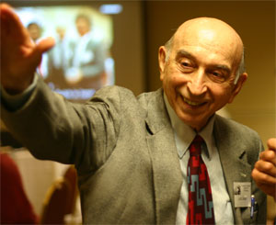
Soft Computing
Evolving collection of methodologies, which aims to exploit tolerance for imprecision, uncertainty, and partial truth to achieve robustness, tractability and low cost
[Lotfi A. Zadeh, 2006]

Slide 11
Case Example that can be solved using Fuzzy
Convolutional Neural Network

Slide 12
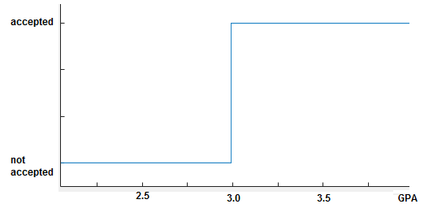
Scholarship Selection
A university wants to provide some scholarships to their outstanding students
Define classical rule
Select students based on their current GPA
if GPA >= 3.0 then
accept

Slide 13
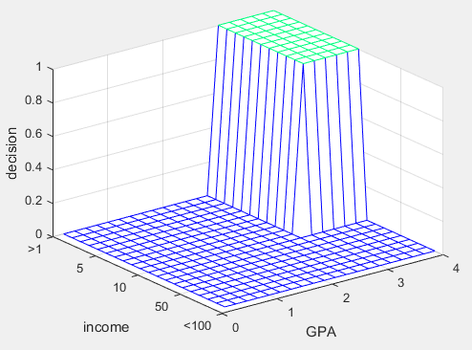
Scholarship Selection
The selection criteria is too broad, add more parameter
Add more classic rule
Select students based on their parent’s income
if GPA >= 3.0 and income<10 then
accept

Slide 14
Scholarship Selection
Then come a specific case:
Candidate | GPA | Parents’ Income IDR/month
A | 3.00 | 9,500,000
B | 2.98 | 1,000,000
if GPA >= 3.0 and income<10 then
accept

Slide 15
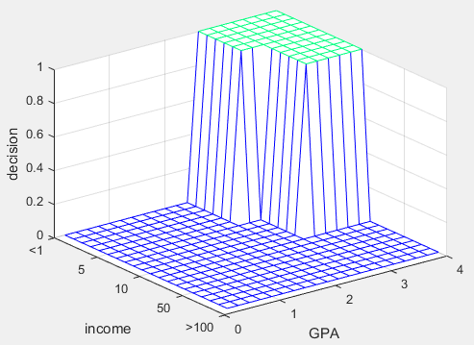
Scholarship Selection
Then come a specific case:
add a new rule
Candidate | GPA | Parents’ Income IDR/month
A | 3.00 | 9,500,000
B | 2.98 | 1,000,000
if (GPA >= 3.0 and income<10) or
(GPA>=2.5 and income<5)
then
accept

Slide 16
Scholarship Selection
What if the University can only provide 5 scholarships, and there are 6 qualified applicants?
if (GPA >= 3.0 and income<10) or
(GPA>=2.5 and income<5)
then
accept

Slide 17
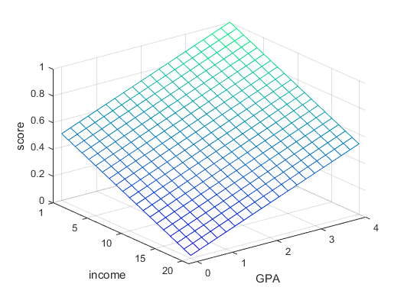
Scholarship Selection
What if the University can only provide 5 scholarships, and there are 6 qualified applicants?
Change the binary decision to a scoring system [0,1]
Score = (GPA/4 + (20-income)/19)/2

Slide 18
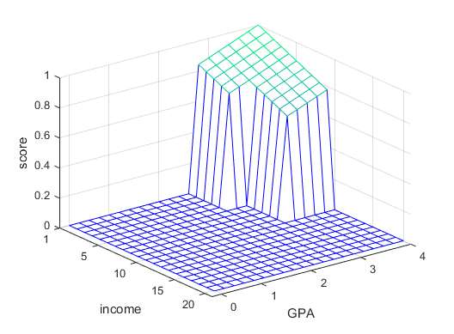
Scholarship Selection
Combine and Adjust to original rule:
if (GPA >= 3.0 and income<10) or
(GPA>=2.5 and income<5)
then
score = (GPA/4+(20-income)/19)/2
else
score = 0

Slide 19

Scholarship Selection
More specific cases?
Further modifying the rule to adapt the situation
if(GPA>=2.5 and income<6) then
score = 2*(20-income)/19-0.8;
if(GPA>=3 and income<6) then
score = (20-income)/19
if(GPA<3 and 6<income<10) then
score = (GPA/4+(20-income)/19)/2;

Slide 20
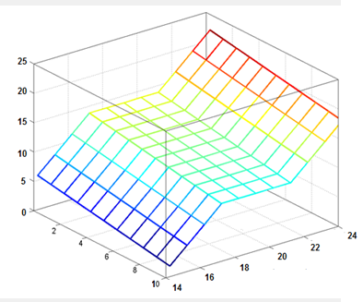
Scholarship Selection
Extended Rule
Complicated function
Not easy to modify
Not intuitive
Many hard-coded parameters
Not easy to understand
Fuzzy can help this

Slide 21
Fuzzy Value and Fuzzy Set
Convolutional Neural Network

Slide 22
Fuzzy, Crisp, and Probability
Crisp Facts
clear and distinct boundaries
“either-or”
Fuzzy Facts
imprecise boundaries
“more-or-less”
Probability
incomplete facts
“might-be”, “chance”

Slide 23
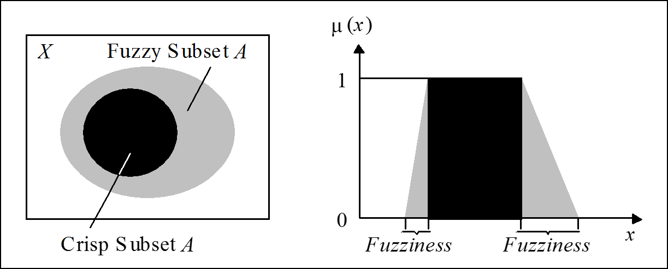
Fuzzy vs Crisp value
Crisp value has distinct boundary between 1 and 0
Fuzzy vale consist of a crisp value, and a gray area to bridge the values

Slide 24
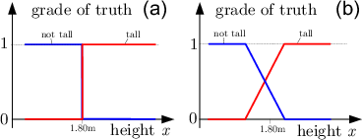
Fuzzy vs Crisp value

Slide 25
Fuzzy vs Probability
Probability
likelihood that a future event will occur
Probability event is in a set
Fuzzy Logic
Measures ambiguity of event that has already occurred
Degree of membership in a set

Slide 26
Linguistic Variables
A linguistic variable is a fuzzy variable
A variable whose values are words or sentences in a natural or artificial language
Age is a linguistic variable if its values are linguistic rather than numerical,
i.e., young, not young, very young, quite young, old, not very old and not very young, etc.,
rather than 20, 21,22, 23

Slide 27
Linguistic Variables
Treating Truth as a linguistic variable with values such as true, very true, completely true, not very true, untrue, etc., leads to what is called fuzzy logic.
By providing a basis for approximate reasoning, that is, a mode of reasoning which is not exact nor very inexact, such logic may offer a more realistic framework for human reasoning than the traditional two-valued logic.

Slide 28
Membership Function
Convolutional Neural Network

Slide 29
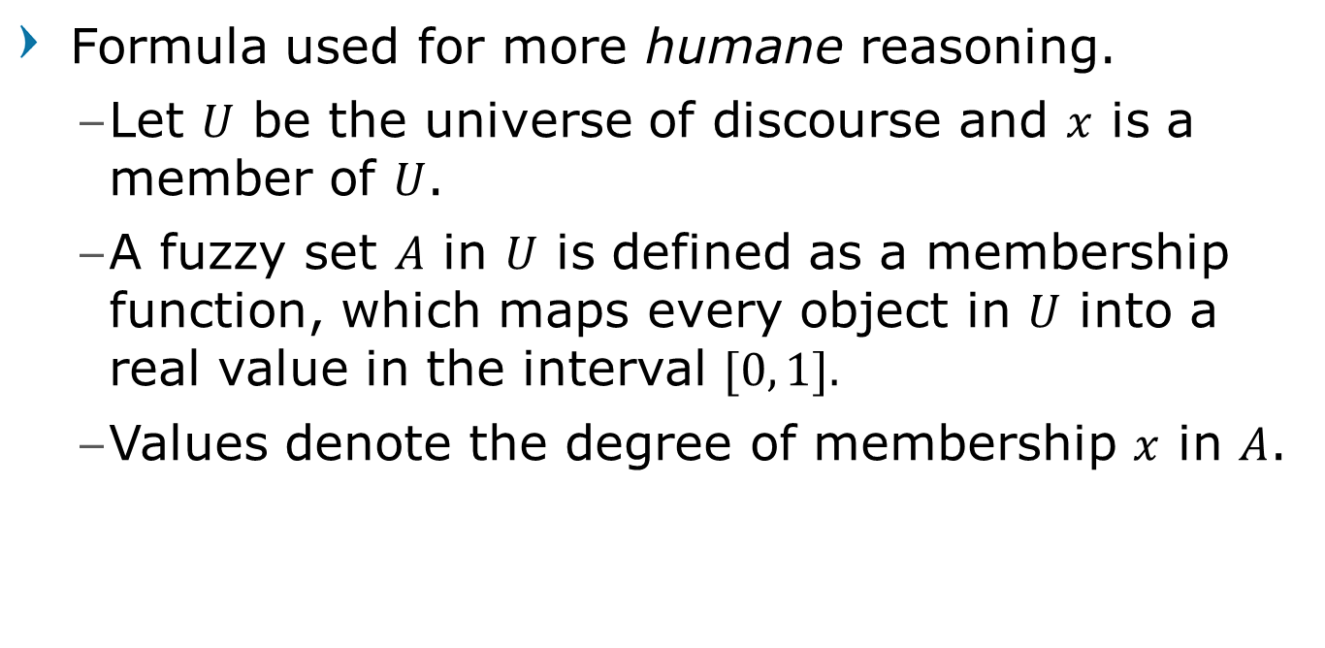
Membership Function
Formula used for more humane reasoning.
Let $U$ be the universe of discourse and $x$ is a member of $U$.
A fuzzy set $A$ in $U$ is defined as a membership function, which maps every object in $U$ into a real value in the interval $[0, 1].$
Values denote the degree of membership $x$ in $A$.

Slide 30

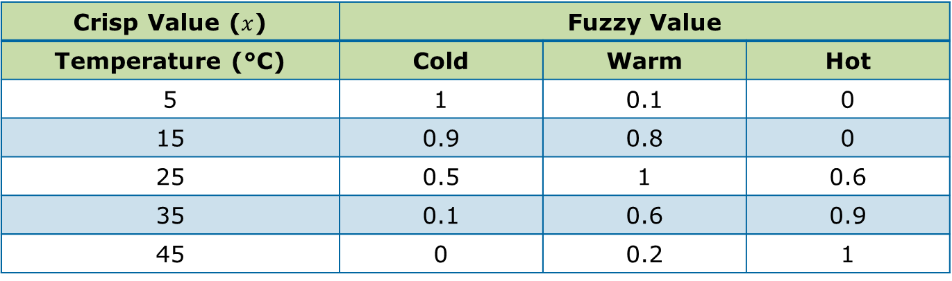
Degree of Membership Example
$U$ is universe of discourse of temperature $[−∞, ∞]$
A is a Fuzzy set Temperature with 3 Linguistics: Cold, Warm, Hot
Fuzzy set maps $U$ into $A$ as degree of membership in range of [0,1]
Crisp Value ($x$) | Fuzzy Value
Temperature (°C) | Cold | Warm | Hot
5 | 1 | 0.1 | 0
15 | 0.9 | 0.8 | 0
25 | 0.5 | 1 | 0.6
35 | 0.1 | 0.6 | 0.9
45 | 0 | 0.2 | 1

Slide 31
Membership Functions
Membership function usually described as a mathematical graph function
Linear Function:
Triangles, Trapezoidal
Sigmoid Function and Bell Function:
Phi, Beta, Gauss

Slide 32
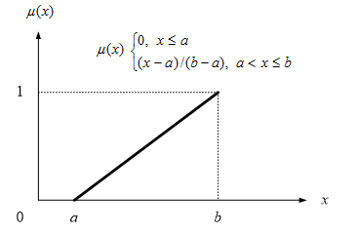
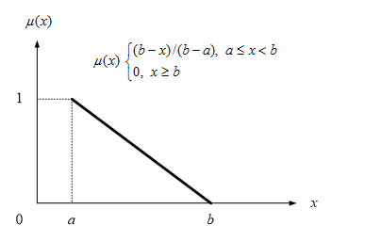
Linear Membership Function
Illustrates linear progression in fuzzy value that bridge one value to another

Slide 33
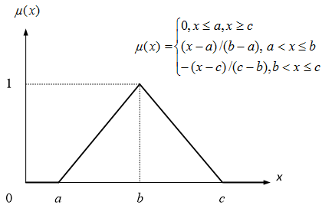
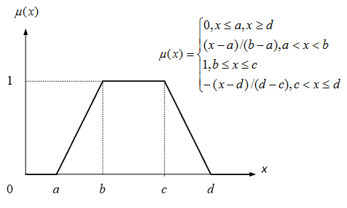
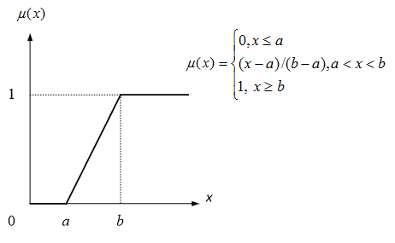
Linear Membership Function
Combination of two linear membership function make the function looks triangular or trapezoidal

Slide 34
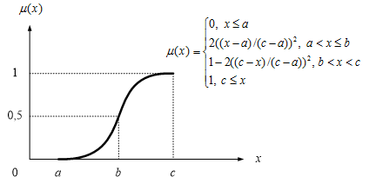
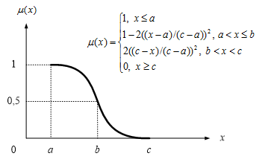
Sigmoid Membership Function
Illustrates progression from small beginnings that accelerates and approaches a climax over time
When a specific mathematical model is lacking, a sigmoid function is often used

Slide 35
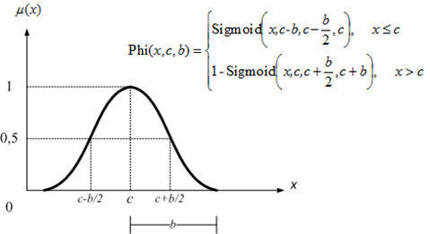
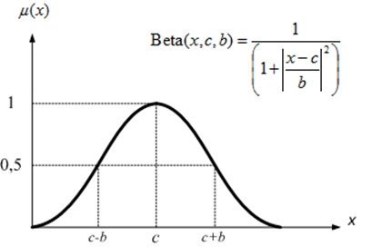
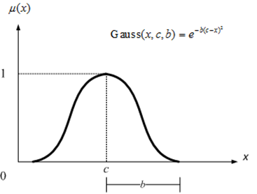
Sigmoid Membership Function
Various functions to represent sigmoid such ass bell and gaussian

Slide 36
Building Fuzzy System
Convolutional Neural Network

Slide 37
Fuzzy System
Consist of 3 main process
Fuzzification
Transform crisp input into fuzzy values based-on its corresponding Membership Function
Inference
Determine the fuzzy output using predefined rule
Defuzzification
Transform back the output fuzzy value into crisp value

Slide 38
Fuzzy System
To build a fuzzy system, we need to design and specify:
Number of input and output Linguistic
Input Membership Functions
Fuzzy Rules
Defuzzification Method
Output Membership Function
Ideally these rules and functions are provided by “the expert in the appropriate field”

Slide 39
Designing Fuzzy System for Scholarship Selection
For this example, let’s pretend that we are “the expert in this field”
Convolutional Neural Network

Slide 40
Step 1: Determine the input and output
Just as the example has been given previously, the inputs for the selection are GPA and Parent’s income, while the output is the Acceptance score
Design the Linguistic Variable for each Input, let’s specify each into three (3) linguistics such as:
GPA: High, Average, Low
Income: Upper, Middle, Bottom
For the output, we design also three (3) Linguistic
Score: Accepted, Considered, Rejected

Slide 41
Step 2: Design the Membership Functions
Design the membership function for each Linguistic
Membership Function for GPA( High )
The range of GPA is [0,4]
From there, we determine that GPA>3.25 is definitely High, and GPA≤2.5 is definitely Not High
Therefore the range (2.5, 3.25] is the fuzzy area between High and Not High
Let’s say that the progression between GPA High and Not High is linear,
thus we have

Slide 42

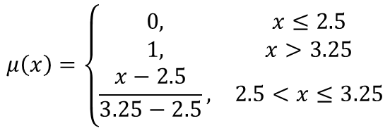
Step 2: Design the Membership Functions
Design the membership function for each Linguistic
Membership Function for GPA( High )
$$μ\left(x\right)=\left\{\begin{matrix}0, & x≤2.5 \\ 1, & x>3.25 \\ \frac{x−2.5}{3.25−2.5}, & 2.5<x≤3.25\end{matrix}\right.$$
$$μ$$

Slide 43


Step 2: Design the Membership Functions
Membership Function for GPA( Low )
Here, we determine that GPA≤1 is Low, and GPA>1.75 is Not Low
Using the same linear function, we have
$$μ\left(x\right)=\left\{\begin{matrix}1, & x≤1 \\ 0, & x>1.75 \\ \frac{1.75−x}{1.75−1}, & 1<x≤1.75\end{matrix}\right.$$
$$μ$$

Slide 44


Step 2: Design the Membership Functions
Membership Function for GPA( Average )
The Average GPA is considered between 2.2 to 2.8
While GPA≤1 or GPA>3.5 is considered Not Average
Using the same linear function, we have
$$μ\left(x\right)=\left\{\begin{matrix}\begin{matrix}0, & x≤1, x>3.5 \\ \frac{x−1}{2.2−1}, & 1<x≤2.2\end{matrix} \\ \begin{matrix}1, & 2.2<x≤2.8 \\ \frac{3.5−x}{3.5−2.8}, & 2.8<x≤3.5\end{matrix}\end{matrix}\right.$$
$$μ$$

Slide 45
Step 2: Design the Membership Functions
If we combine the Membership Function for GPA it’ll look like:
Do the same for Income

Slide 46
Step 2: Design the Membership Functions
Membership Function for Parent’s Income
We determine that Income>16 million is considered as Upper with fuzziness starts from 12 million, and
Income≤4 million is considered as Bottom, and by 8 million it’s no longer considered Bottom
Income between 8 to 11 million is considered as Middle with fuzziness starts from 5 to 15 million

Slide 47
Step 3: Design the Fuzzy Rules
Define rules that will determine Accepted or Rejected score based on GPA and Income inputs
With 2 inputs and 3 linguistics each, there will be 3x3=9 rules (combinatorial)
Basic rule form:
if GPA='High' and Income='Bottom' then Score='Accepted’
...
if GPA='Average' and Income='Middle' then Score='Considered’
...
if GPA='Low' and Income='Upper' then Score='Rejected’
...

Slide 48
Step 3: Design the Fuzzy Rules
Or define it as a table
GPA | Income | Score
High | Upper | Considered
High | Middle | Accepted
High | Bottom | Accepted
Average | Upper | Considered
Average | Middle | Considered
Average | Bottom | Accepted
Low | Upper | Rejected
Low | Middle | Rejected
Low | Bottom | Considered

Slide 49
Step 4: Choose Defuzzification Method
Process that maps a fuzzy set back to a crisp set
Common methods:
Center of Gravity (Mamdani-style)
Constant Defuzzification (Takagi-Sugeno-style)
Other common methods:
Mean of Maxima
Weighted Average
Middle of Maxima
Singleton
Etc.

Slide 50
Step 4: Choose Defuzzification Method
Center of Gravity (Mamdani-style)
Has the same Membership form as input
For example, let the output membership function be:

Slide 51
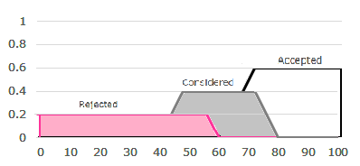
Step 4: Choose Defuzzification Method
Center of Gravity (Mamdani-style)
Clipping using MAX-MIN method to “chop off” parts of Membership based on the fuzzy output obtained from rule inferencing, then Aggregate the clipped membership
For example, we obtained fuzzy output
Rejected(0.2)
Considered(0.4)
Accepted(0.6)

Slide 52
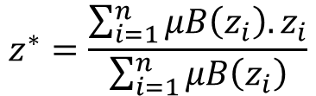
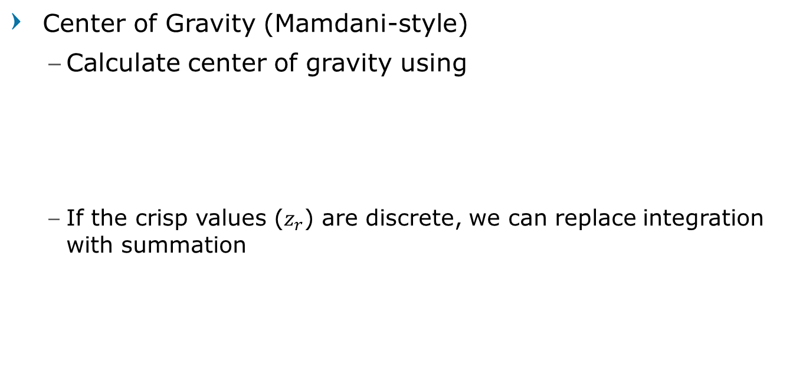
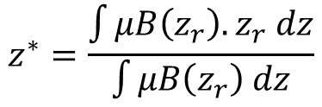
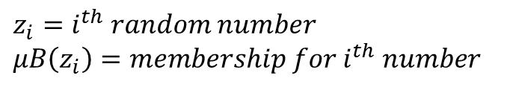
Step 4: Choose Defuzzification Method
Center of Gravity (Mamdani-style)
Calculate center of gravity using
If the crisp values ($z_{r}$) are discrete, we can replace integration with summation
$$z^{∗}=\frac{\int{μB\left(z_{r}\right).z_{r} dz}}{\int{μB\left(z_{r}\right) dz}}$$
$$z^{∗}=\frac{\sum_{i=1}^{n}{μB\left(z_{i}\right). z_{i}}}{\sum_{i=1}^{n}{μB\left(z_{i}\right)}}$$
$z_{i}=i^{th} random number$
$μB\left(z_{i}\right)=membership for i^{th} number$

Slide 53
Step 4: Choose Defuzzification Method
Constant Defuzzification (Takagi-Sugeno-style)
Choose a constant value to represent each output linguistic
For example, set the constant value to 50, 70, and 100

Slide 54
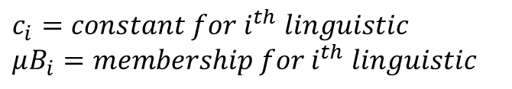

Step 4: Choose Defuzzification Method
Constant Defuzzification (Takagi-Sugeno-style)
Using fuzzy output obtained from rule inferencing
Calculate crisp output using
$$z^{∗}=\frac{\sum_{i=1}^{l}{μB_{i}. c_{i}}}{\sum_{i=1}^{l}{μB_{i}}}$$
$c_{i}=constant for i^{th} linguistic$
$μB_{i}=membership for i^{th} linguistic$

Slide 55
Fuzzy System for Scholarship Selection
Test to an example
Convolutional Neural Network

Slide 56
Case Example
Student A has GPA of 3.01 with Parental Income of 14M
Student B has GPA of 2.90 with Parental Income of 5.5M

Slide 57
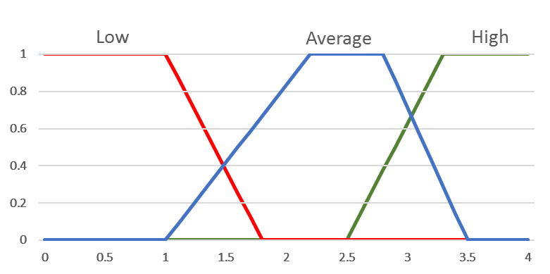
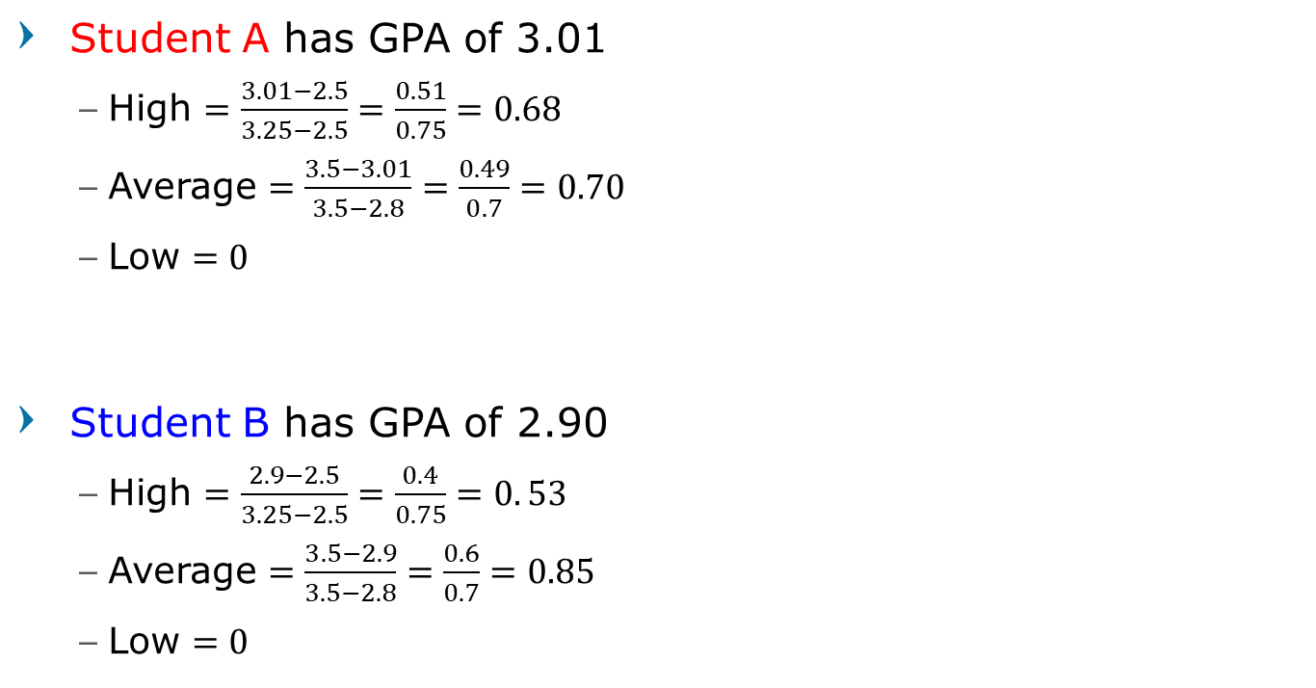
Fuzzification - GPA
Student A has GPA of 3.01
High $=\frac{3.01−2.5}{3.25−2.5}=\frac{0.51}{0.75}=0.68$
Average $=\frac{3.5−3.01}{3.5−2.8}=\frac{0.49}{0.7}=0.70$
Low $=0$
Student B has GPA of 2.90
High $=\frac{2.9−2.5}{3.25−2.5}=\frac{0.4}{0.75}=0. 53$
Average $=\frac{3.5−2.9}{3.5−2.8}=\frac{0.6}{0.7}=0.85$
Low $=0$

Slide 58
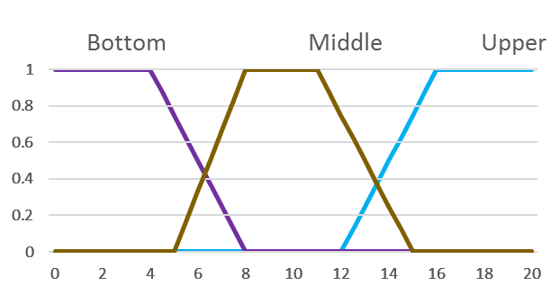
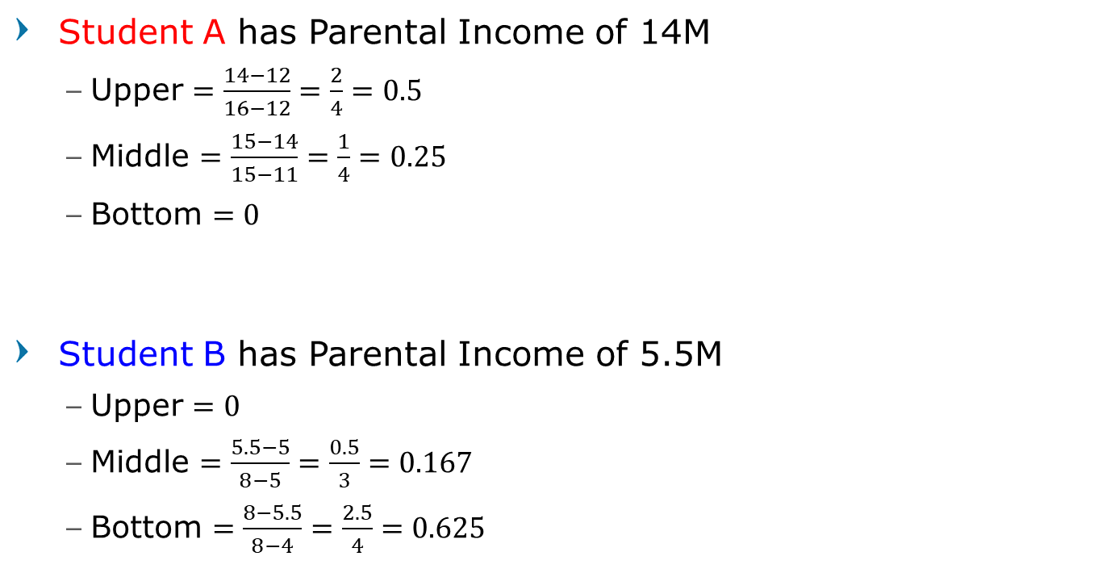
Fuzzification - Income
Student A has Parental Income of 14M
Upper $=\frac{14−12}{16−12}=\frac{2}{4}=0.5$
Middle $=\frac{15−14}{15−11}=\frac{1}{4}=0.25$
Bottom $=0$
Student B has Parental Income of 5.5M
Upper $=0$
Middle $=\frac{5.5−5}{8−5}=\frac{0.5}{3}=0.167$
Bottom $=\frac{8−5.5}{8−4}=\frac{2.5}{4}=0.625$

Slide 59
Inference
Apply the inference rule to the fuzzy inputs to obtain the fuzzy output
Using Clipping technique, the conjunction rule will get the minimum value of fuzzy input as the fuzzy output
For example, for Student A, we will get
if GPA='High(0.68)' and Income='Bottom(0)' then Score='Accepted(0)’
...
if GPA='Average(0.70)' and Income='Middle(0.25)' then Score='Considered(0.25)’
...
if GPA=‘Low(0)' and Income='Upper(0.5)' then Score='Rejected(0)’
...

Slide 60
Inference
Thus we have
Student A
GPA |  | Income |  | Score
High | 0.68 | Upper | 0.5 | Considered | 0.5
High | 0.68 | Middle | 0.25 | Accepted | 0.25
High | 0.68 | Bottom | 0 | Accepted | 0
Average | 0.70 | Upper | 0.5 | Considered | 0.5
Average | 0.70 | Middle | 0.25 | Considered | 0.25
Average | 0.70 | Bottom | 0 | Accepted | 0
Low | 0 | Upper | 0.5 | Rejected | 0
Low | 0 | Middle | 0.25 | Rejected | 0
Low | 0 | Bottom | 0 | Considered | 0
Student B
GPA |  | Income |  | Score
High | 0.53 | Upper | 0 | Considered | 0
High | 0.53 | Middle | 0.167 | Accepted | 0.167
High | 0.53 | Bottom | 0.625 | Accepted | 0.53
Average | 0.85 | Upper | 0 | Considered | 0
Average | 0.85 | Middle | 0.167 | Considered | 0.167
Average | 0.85 | Bottom | 0.625 | Accepted | 0.625
Low | 0 | Upper | 0 | Rejected | 0
Low | 0 | Middle | 0.167 | Rejected | 0
Low | 0 | Bottom | 0.625 | Considered | 0

Slide 61
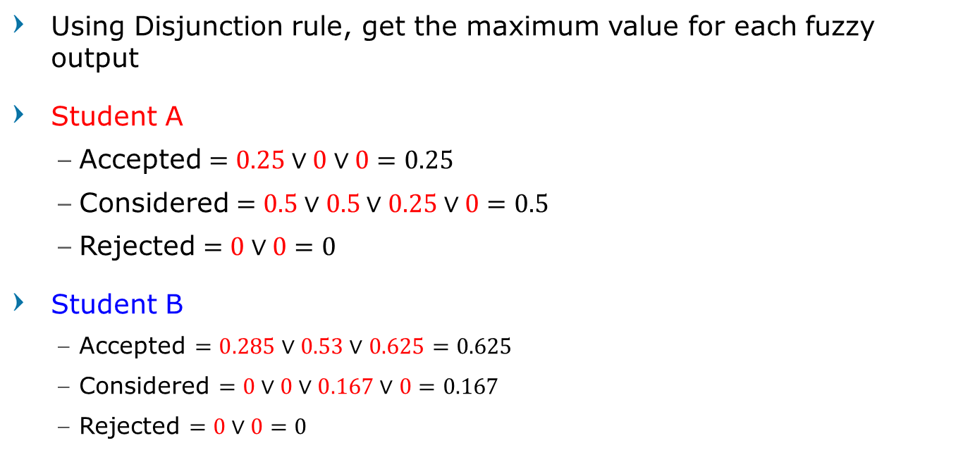
Inference
Using Disjunction rule, get the maximum value for each fuzzy output
Student A
Accepted $=0.25∨0∨0=0.25$
Considered $=0.5∨0.5∨0.25∨0=0.5$
Rejected $=0∨0=0$
Student B
Accepted $=0.285∨0.53∨0.625=0.625$
Considered $=0∨0∨0.167∨0=0.167$
Rejected $=0∨0=0$

Slide 62
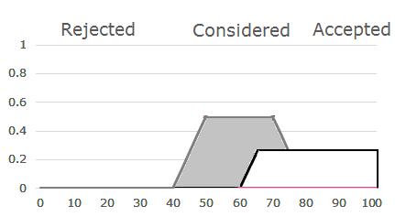
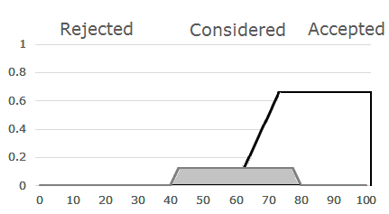

Defuzzification – Mamdani
Using Clipping technique, we will get
Student A
Accepted $=0.25$
Considered $=0.5$
Rejected $=0$
Student B
Accepted $=0.625$
Considered $=0.167$
Rejected $=0$

Slide 63
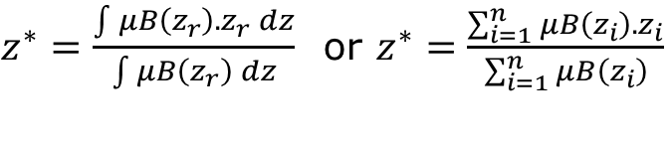
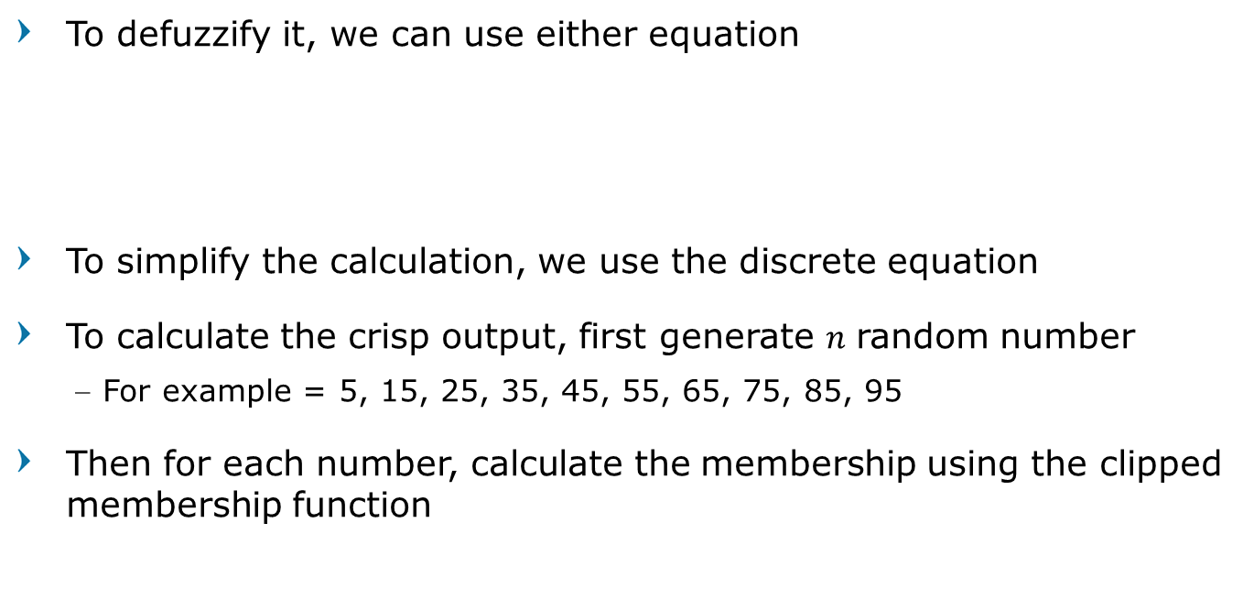
Defuzzification – Mamdani
To defuzzify it, we can use either equation
To simplify the calculation, we use the discrete equation
To calculate the crisp output, first generate $n$ random number
For example = 5, 15, 25, 35, 45, 55, 65, 75, 85, 95
Then for each number, calculate the membership using the clipped membership function
$z^{∗}=\frac{\int{μB\left(z_{r}\right).z_{r} dz}}{\int{μB\left(z_{r}\right) dz}}$ or $z^{∗}=\frac{\sum_{i=1}^{n}{μB\left(z_{i}\right). z_{i}}}{\sum_{i=1}^{n}{μB\left(z_{i}\right)}}$

Slide 64
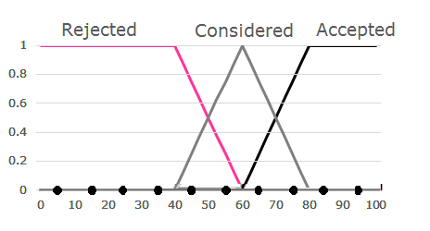
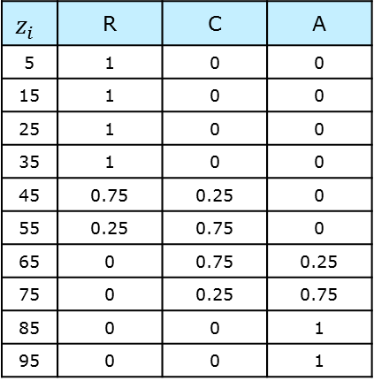
Defuzzification – Mamdani
First calculate the membership of each random generated number using the designed output Membership Function
$$z_{i}$$ | R | C | A
5 | 1 | 0 | 0
15 | 1 | 0 | 0
25 | 1 | 0 | 0
35 | 1 | 0 | 0
45 | 0.75 | 0.25 | 0
55 | 0.25 | 0.75 | 0
65 | 0 | 0.75 | 0.25
75 | 0 | 0.25 | 0.75
85 | 0 | 0 | 1
95 | 0 | 0 | 1

Slide 65
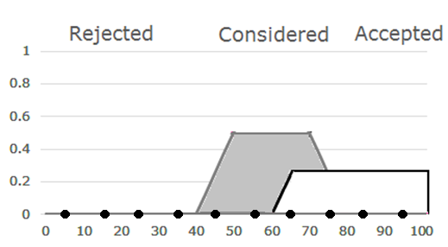

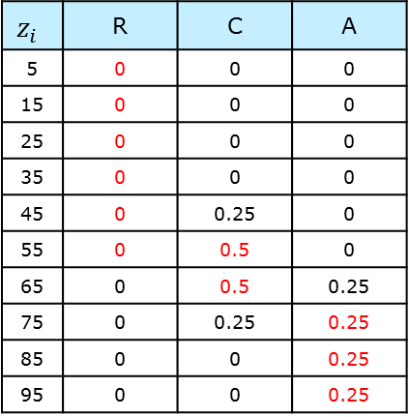
Defuzzification – Mamdani
Maximized (threshold) the value based on the clipped membership
Student A
Accepted $=0.25$, Considered $=0.5$
Rejected $=0$
$$z_{i}$$ | R | C | A
5 | 0 | 0 | 0
15 | 0 | 0 | 0
25 | 0 | 0 | 0
35 | 0 | 0 | 0
45 | 0 | 0.25 | 0
55 | 0 | 0.5 | 0
65 | 0 | 0.5 | 0.25
75 | 0 | 0.25 | 0.25
85 | 0 | 0 | 0.25
95 | 0 | 0 | 0.25

Slide 66

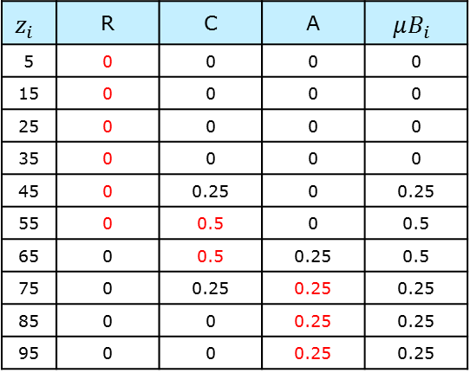
Defuzzification – Mamdani
Output Membership is the maximum value from each linguistic
Student A
Accepted $=0.25$, Considered $=0.5$
Rejected $=0$
$$z_{i}$$ | R | C | A | $$μB_{i}$$
5 | 0 | 0 | 0 | 0
15 | 0 | 0 | 0 | 0
25 | 0 | 0 | 0 | 0
35 | 0 | 0 | 0 | 0
45 | 0 | 0.25 | 0 | 0.25
55 | 0 | 0.5 | 0 | 0.5
65 | 0 | 0.5 | 0.25 | 0.5
75 | 0 | 0.25 | 0.25 | 0.25
85 | 0 | 0 | 0.25 | 0.25
95 | 0 | 0 | 0.25 | 0.25

Slide 67
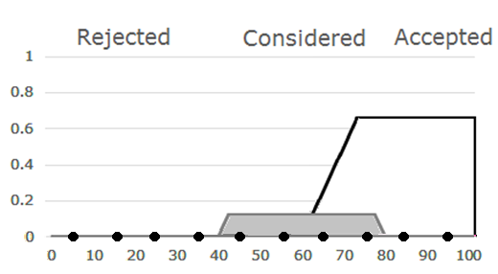


Defuzzification – Mamdani
Do the same for Student B
Student B
Accepted $=0.625$, Considered $=0.167$
Rejected $=0$
$$z_{i}$$ | R | C | A | $$μB_{i}$$
5 | 0 | 0 | 0 | 0
15 | 0 | 0 | 0 | 0
25 | 0 | 0 | 0 | 0
35 | 0 | 0 | 0 | 0
45 | 0 | 0.167 | 0 | 0.167
55 | 0 | 0.167 | 0 | 0.167
65 | 0 | 0.167 | 0.25 | 0.25
75 | 0 | 0.167 | 0.625 | 0.625
85 | 0 | 0 | 0.625 | 0.625
95 | 0 | 0 | 0.625 | 0.625

Slide 68





Defuzzification – Mamdani
Lastly, calculate the crisp output using equation
Student A
$$z^{∗}=\frac{\sum_{i=1}^{n}{μB\left(z_{i}\right). z_{i}}}{\sum_{i=1}^{n}{μB\left(z_{i}\right)}}$$
$$z_{i}$$ | $$μB_{i}$$ | $$z_{i}∗μB_{i}$$
5 | 0 | 0
15 | 0 | 0
25 | 0 | 0
35 | 0 | 0
45 | 0.25 | 11.25
55 | 0.5 | 27.5
65 | 0.5 | 32.5
75 | 0.25 | 18.75
85 | 0.25 | 21.25
95 | 0.25 | 23.75
$$∑$$ | 2 | 135
$z^{∗}=\frac{\begin{aligned}\left(5∗0\right)+\left(15∗0\right)+\left(25∗0\right)+\left(35∗0\right)+\left(45∗0.25\right)+\left(55∗0.5\right) \\ +\left(65∗0.5\right)+\left(75∗0.25\right)+\left(85∗0.25\right)+\left(95∗0.25\right)\end{aligned}}{0+0+0+0+0.25+0.5+0.5+0.25+0.25+0.25}$
$z^{∗}=\frac{11.25+27.5+32.5+21.25+23.75}{2}=\frac{135}{2}$
$z^{∗}=67.5$

Slide 69




Defuzzification – Mamdani
Lastly, calculate the crisp output using equation
Student B
$$z^{∗}=\frac{\sum_{i=1}^{n}{μB\left(z_{i}\right). z_{i}}}{\sum_{i=1}^{n}{μB\left(z_{i}\right)}}$$
$$z_{i}$$ | $$μB_{i}$$ | $$z_{i}∗μB_{i}$$
5 | 0 | 0
15 | 0 | 0
25 | 0 | 0
35 | 0 | 0
45 | 0.167 | 7.51
55 | 0.167 | 9.18
65 | 0.25 | 16.25
75 | 0.625 | 46.87
85 | 0.625 | 53.12
95 | 0.625 | 59.37
$$∑$$ | 2.46 | 192.325
$z^{∗}=\frac{\begin{aligned}\left(5∗0\right)+\left(15∗0\right)+\left(25∗0\right)+\left(35∗0\right)+\left(45∗0.167\right)+\left(55∗0.167\right) \\ +\left(65∗0.25\right)+\left(75∗0.625\right)+\left(85∗0.625\right)+\left(95∗0.625\right)\end{aligned}}{0+0+0+0+0.167+0.167+0.25+0.625+0.625+0.625}$
$z^{∗}=\frac{7.51+9.18+16.25+46.87+53.12+59.37}{2.459}=\frac{192.325}{2.459}$
$z^{∗}=78.21$

Slide 70




Defuzzification – Mamdani
Apply the fuzzy output to the equation
Student A
Student B
$z^{∗}=\frac{11.25+27.5+32.5+21.25+23.75}{2}=\frac{135}{2}$
$z^{∗}=67.5$
$z^{∗}=\frac{7.51+9.18+16.25+46.87+53.12+59.37}{2.459}=\frac{192.325}{2.459}$
$z^{∗}=78.21$

Slide 71



Defuzzification – Sugeno
Apply the fuzzy output to the equation
Student A
Accepted $=0.25$
Considered $=0.5$
Rejected $=0$
Student B
Accepted $=0.625$
Considered $=0.167$
Rejected $=0$
$$z^{∗}=\frac{\sum_{i=1}^{l}{μB_{i}. c_{i}}}{\sum_{i=1}^{l}{μB_{i}}}$$

Slide 72




Defuzzification – Sugeno
Apply the fuzzy output to the equation
Student A
Student B
$$z^{∗}=\frac{\left(0.25∗100\right)+\left(0.5∗70\right)+(0∗50)}{0.25+0.5+0}$$
$$z^{∗}=\frac{25+35+0}{0.75}=80$$
$$z^{∗}=\frac{\left(0.625∗100\right)+\left(0.167∗70\right)+(0∗50)}{0.625+0.167+0}$$
$$z^{∗}=\frac{62.5+11.69+0}{0.792}=93.67$$

Slide 73
Question?
Convolutional Neural Network

